Slide 1
RATHINAM
CENTRE OF EXCELLENCE
Database Management System
ER Diagrams
by
Mrs.B.Sharmila
Technical trainer

Slide 2
Introduction to ER Model
ER Model is used to model the logical view of the system from data perspective.
An ER model is a design or blueprint of a database that can later be implemented as a database.
The main components of E-R Diagram are:
Entity set
Attributes
Relationship set

Slide 3
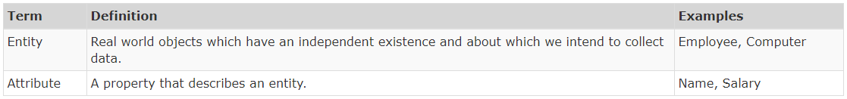
Introduction to ER Model

Slide 4
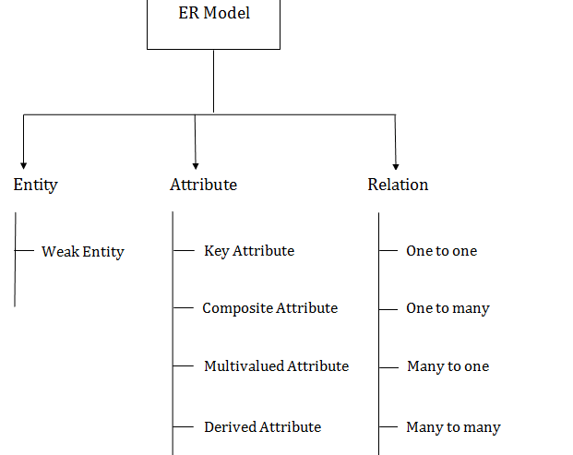

Slide 5
Entity
An Entity may be an object with a physical or conceptual existence.
An Entity is something that is present in an organization or institute and needs to be represented in the database.
They are primarily nouns such as customer, location, concept, event, or person.
They are essential for the representation of data.

Slide 6
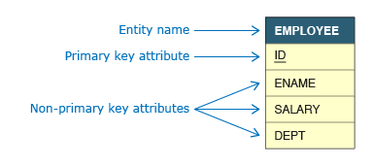
Example of Entities
A sample ER Diagram representing the Employee entity along with its attributes is presented below:

Slide 7
Categories of Entities
There are three different types of entities, and we will briefly discuss them along with their symbols.
Strong entities are also referred to as the parent entity as sometimes weak entities can rely on them.
They also have primary keys distinguishing them from the other categories.
Entity
An entity that depends on another entity called a weak entity.
They lose their meaning if a parent entity does not exist and they have no primary key.
Weak Entity

Slide 8
Categories of Entities
They tend to associate several entity types together depending on the several instances.
They are also known to contain the attributes for the relationship between those entity types.
Associative Entity

Slide 9
Entity Type
It refers to the category that a particular entity belongs to.
Example :
A table named student in a university database.
A table named employee in a company database.
Note :
The category of a particular entity in the relation in RDBMS is called the entity type.
It is represented by the name of the table and its schema.
Student
Entity Type

Slide 10
Entity Set
An entity set is a collection or set of all entities of a particular entity type at any point in time.
The type of all the entities should be the same.
Example:
The collection of all the students from the student table at a particular instant of time is an example of an entity set.
The collection of all the employees from the employee table at a particular instant of time is an example of an entity set.
E1
E2
E3
Entity Set

Slide 11
Difference Between Strong and weak entity set
Strong Entity Set | Weak Entity Set
Strong entity set always has a primary key | It does not have enough attributes to build a primary key.
It is represented by a rectangle symbol. | It is represented by a double rectangle symbol.
It contains a Primary key represented by the underline symbol. | It contains a Partial Key which is represented by a dashed underline symbol.
The member of a strong entity set is called as dominant entity set. | The member of a weak entity set called as a subordinate entity set.
Primary Key is one of its attributes which helps to identify its member. | It is a combination of primary key and partial key of the strong entity set.
In the ER diagram, the relationship between two strong entity set shown by using a diamond symbol. | The relationship between one strong and a weak entity set shown by using the double diamond symbol.
The connecting line of the strong entity set with the relationship is single. | The line connecting the weak entity set for identifying relationship is double.

Slide 12
Attribute
An attribute describes the property of an entity.
An attribute is represented as Oval in an ER diagram.
There are four types of attributes:
Key attribute
Composite attribute
Multivalued attribute
Derived attribute
Attribute

Slide 13
Key Attribute
A key attribute can uniquely identify an entity from an entity set.
For example, student roll number can uniquely identify a student from a set of students.
Key attribute is represented by oval same as other attributes however the text of key attribute is underlined.
RollNo

Slide 14
Key Attribute
A key attribute can uniquely identify an entity from an entity set.
For example, student roll number can uniquely identify a student from a set of students.
Key attribute is represented by oval same as other attributes however the text of key attribute is underlined.
RollNo

Slide 15
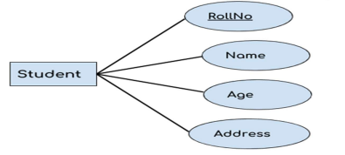
Key Attribute

Slide 16
Composite Attribute
An attribute that is a combination of other attributes is known as composite attribute.
For example, In student entity, the student address is a composite attribute as an address is composed of other attributes such as pin code, state, country.
Pincode
Student
Address
State
Country

Slide 17
Multivalued Attribute
An attribute that can hold multiple values is known as multivalued attribute.
It is represented with double ovals in an ER Diagram.
For example – A Student can have more than one phone numbers so the phone number attribute is multivalued.
Phone1
Student
Mobile Number
Phone2
Phone3

Slide 18
Derived Attributes
A derived attribute is one whose value is dynamic and derived from another attribute.
It is represented by dashed oval in an ER Diagram.
For example – Person age is a derived attribute as it changes over time and can be derived from another attribute (Date of birth).
DateOfBirth
Student
Age

Slide 19
Activity – Finding the type of Attributes
Address
Age
Student
Mobile Number
ID
Name
Date Of Birth

Slide 20
Relationship
Relationships are associations of one entity with another entity through a foreign key.
Each relationship has a name .
For example, Teacher teaches student.
So Teacher entity is related to Student entity by teaches relationship.
In ER diagram, relationship type is represented by a diamond and connecting the entities with lines.
Teacher
teaches
Student

Slide 21
Degree of a Relationship
The number of entity sets participating in a relationship is called as degree of a relationship .
Unary relationship
Binary relationship
Ternary relationship

Slide 22
Unary Relationship
When there is only ONE entity set participating in a relation, the relationship is called as unary relationship.
Employee
Reports to

Slide 23
Binary Relationship
When there are association among two entities then the relationship is called as binary relationship.
Student
Enrolled
Course

Slide 24
Ternary Relationship
When there are association among three entities then the relationship is called as Ternary relationship.
Teacher
Subject
Teaches
Student

Slide 25
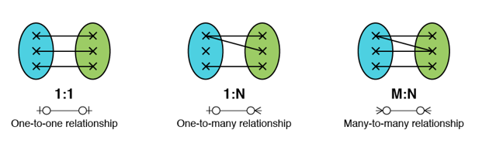
Cardinality of Relations
Maximum number of relationship instance that an entity can participate in.
Cardinality ratio can be,
One to One (1:1)
One to Many (1:N)
Many to One (N:1)
Many to Many (M:M)
X
X
X
X
X
X
N :1
Many to one relationship

Slide 26
One to One Relations
When a single instance of an entity is associated with a single instance of another entity then it is called one to one relationship.
For example, a employee manages the department.
1
1
Employee
manages
Department

Slide 27
One to Many Relations
When a single instance of an entity is associated with more than one instances of another entity then it is called one to many relationship.
For example – Any number of students can be enrolled in a course and a course can be enrolled by any number of students.
N
1
Student
Enrolled in
Course

Slide 28
Many to Many Relations
When more than one instances of an entity is associated with more than one instances of another entity then it is called many to many relationship.
For example, Any number of students studies in any number of subject.
N
N
Student
studies
Subject

Slide 29
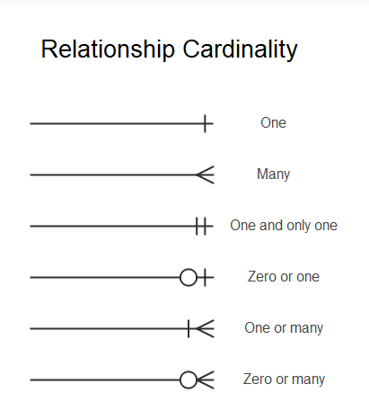
Crowfoot Notations
Crow foot notation is one of the approaches to represent the cardinality of relationship in an ER Model.
The notation comprises of four symbols and one of them needs to be used for each entity in a relationship.

Slide 30
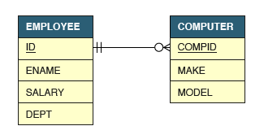
Example Crowfoot Notations
Let us say the relationship between employee and computer is such that a computer must be allocated to one and only one employee but an employee can be allocated with zero or any number of computers. Such a relationship is represented by the diagram below:

Slide 31
Participation Constraints
Specifies whether existence of an entity depends on its being related to another entity.
Total Participation
Partial Participation
Partial participation
Total Participation
Employees
manages
Department

Slide 32
Participation Constraints
Employees
Manages
Department
E1
E2
E3
E4
E5
M1
M2
M3
M4
D1
D2
D3
D4

Slide 33
Total Participation
Each entity in the entity set must participate in the relationship.
If each student must enroll in a course, the participation of student will be total.
Total participation is shown by double line in ER diagram.

Slide 34
Partial Participation
The entity in the entity set may or may NOT participate in the relationship.
If some courses are not enrolled by any of the student, the participation of course will be partial.

Slide 35
Quiz

Slide 36
1.The entity relationship set is represented in E-R diagram as a) Double diamonds b) Undivided rectangles c) Dashed lines d) Diamond
2. An entity set that does not have sufficient attributes to form a primary key is termed a __________ a) Strong entity set b) Variant set c) Weak entity set d) Variable set
3. If you were collecting and storing information about your music collection, an album would be considered a(n) _____ a) Relation b) Entity c) Instance d) Attribute

Slide 37
4.Ellipses represents
a)Relationship sets
b)Attributes
c)Derived attributes
d)Multivalued attributes
5.Diamond represents
a)Relationship sets
b)Attributes
c)Derived attributes
d)Multivalued attributes
6.Which of the following diagram links attributes to entity sets and entity to relationship sets
a)Double lines
a)Dashed lines
a)lines

Slide 38
5.Double ellipses represents
a)Weak entity sets
b)Attributes
c)Derived attributes
d)Multivalued attributes
6.The number of entities to which another entity can be related through a relationship set is called?
(A). Cardinality (B). Entity (C). Schema (D). Attributes
7. If two entities have many to many relationships mostly results in how many tables.
(A). Three (B). Two (C). One (D). Four

Slide 39
8.How the Every weak entity set can be changed into a strong entity set through?
(A). using generalization (B). using aggregation (C). adding appropriate attributes (D). none of the above
9.The attribute AGE is?
(A). Single valued (B). Derived (C). Composite (D). Multi-valued
10. The primary key in a many to one relationship, acts as a foreign key on which side?
(A). On the side where many relationships are defined (B). On the side where a single (one) relationship is defined (C). On both the sides (D). Neither of them

